Slide 1
SYMBIOSIS
Group #1

Slide 2
What is ‘Symbiosis’?
Symbiosis is a TEXT-BASED adventure game, set in a universe where you awake, confused and dazed, in a testing facility. It’s unclear how you got there, or what exactly your purpose in the story is. However, upon confronting enemies that hold a serious resemblance to lab equipment, a sinister and downright absurd plot reveals itself.
CONTENTS:
Multiple endings - depending on your interaction with the enemies and karma level at the end of the game,
A map feature - dynamically updating rooms and revealing icons on the map depending on your location and progression in the story,
Multiple ‘laboratory’ themed weapons - each weapon has distinct characteristics, damage stats, and critical chances,
Enemies / Combat - fulfilling the purpose of allowing for game lore and story to be inferred through dialogue options and action options,
Health system - utilizing a dynamically colour changing health system from the get-go, this feature sets the scene for the fighting that lies ahead of your character,
Music System - immersing yourself in an 8-bit chiptune-fueled adventure.

Slide 3
3
Fully-fleshed, uniquely different endings dependent on story choices

Slide 4
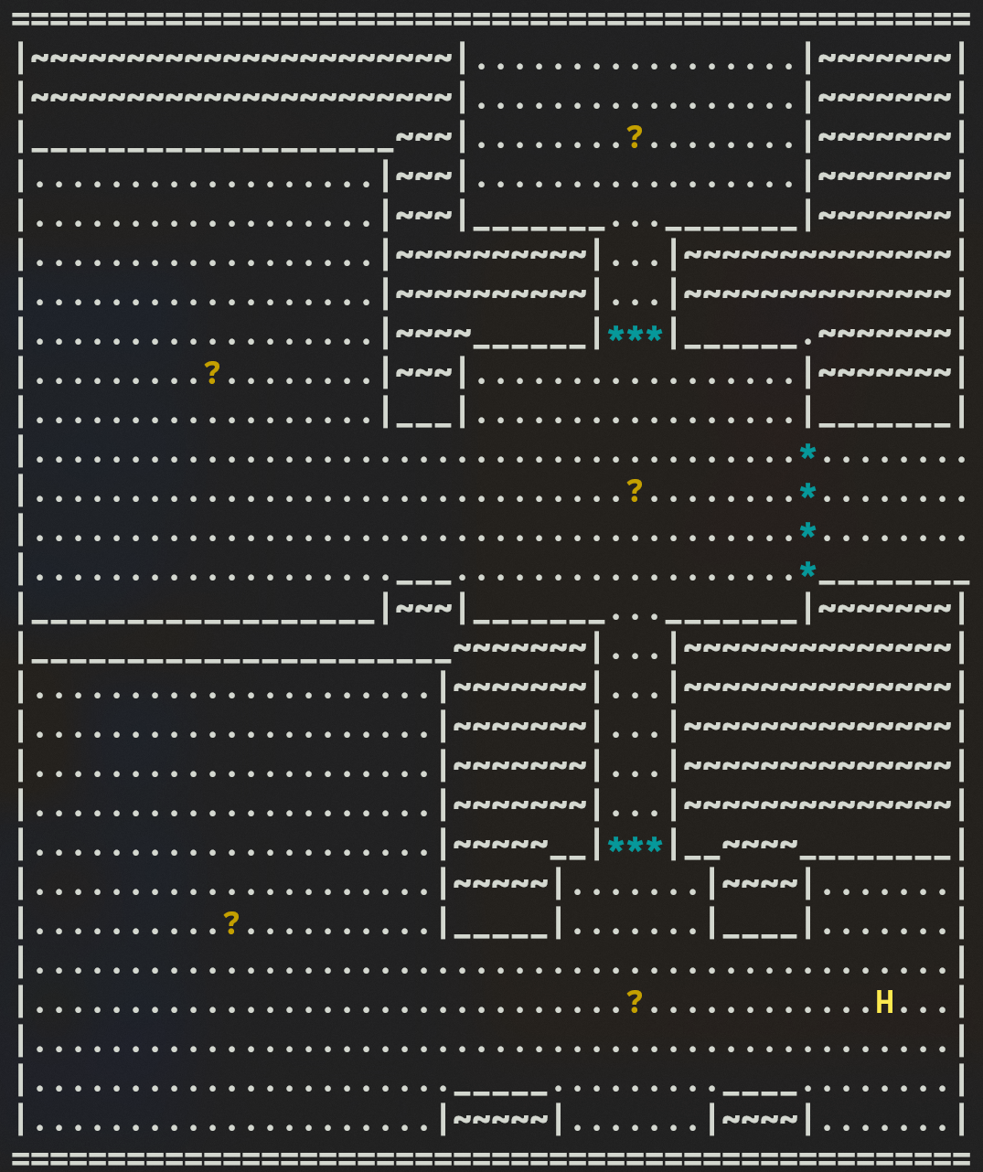
MAP SYSTEM
-> Displays UNDISCOVERED rooms via a ‘?’
-> Displays DISCOVERED rooms via the first letter of the rooms title
- Accomplished via Python3’s f-string feature.

Slide 5
WEAPON SYSTEM
UNIQUE
FIRE-POWER
BALANCE
FUN-FACTOR
Each weapon’s stats reflect the nature of the item itself
Varying min/max damages, critical chances
Ensuring that you become progressively stronger
Hilariously silly weapons that relieve the player from the twisted story

Slide 6
COMBAT SYSTEM
ATTACK
TALK
ACTION
SPARE
Attack your enemy with your current weapon
Learn more about the enemy
Act upon information you’ve learned when talking to your enemy
Spare your enemy, leading a pacifist route
Via an OOP-style of programming, we have future-proofed the implementation of more enemies

Slide 7
HEALTH SYSTEM
-> Updates colour depending on percentage lost.
-> Can be increased via in-game upgrades after fighting specific, on-theme, enemies.

Slide 8
LIBRARIES / EXTERNALS USED
NAME | PURPOSE | LINK
PYGAME | Implementation of music and sound effects using built-in mixer function. | https://www.pygame.org/news
COLORAMA | Implementation of coloured text in the command-line. | https://pypi.org/project/colorama/
ASCII MAPPER | Aiding in the creation of art used within the game. | https://notimetoplay.org/engines/ascii-mapper/

Slide 9
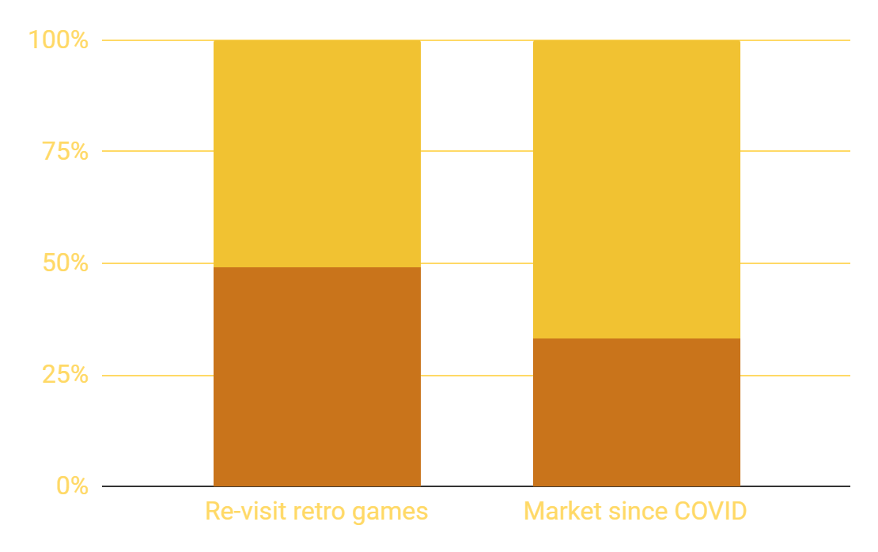
INVESTMENT STATS
Notes:
49% of over 18 european gamers re-visit retro games.
33% in retro-gaming market since e

Slide 10
INVESTMENT
FURTHER FEATURES
MULTIPLAYER
Extensive expansion of levels, items & enemies,
GUI removed from CMD-line.
Cross-compatibility,
Cloud-saves,
Player-versus-player

Slide 11
THANK YOU!
Do you have any questions?
Following your questions, we will present a thorough demonstration of our game.

